Slide 1
Web Based Information System and Navigation
Chapter-7
KEC, Dhapakhel

Slide 2
Structure of the Website
Website structure is the process of defining the look and feel and the navigation of CM websites.
A site structure is normally the role of an information architect, the reality is that everybody from designers to website owners find themselves working on it.
The website structure consists of three components: Layout Templates, URL patterns, and Linkage Structure.

Slide 3
Layout Template
Most web pages consist of HTML elements like table, menu, button, image, and input box.
The layout of a web page describes what HTML elements are included in the page, as well as how these elements are visually distributed in page rendering.
In a website, pages are generated based on distinguishable templates according to their functions.
Visually similar pages usually have same function. In this way, user can easily identify a page’s function at a glance.
Notes:
A page layout is represented by a so called DOM (Document Object Model) tree.

Slide 4
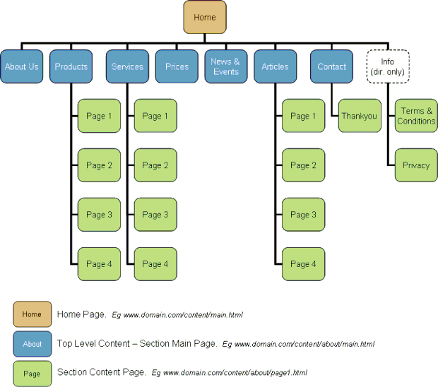
Layout of Site

Slide 5
URL Pattern
A URL pattern is a generalization of a group of URLs sharing similar syntactic format.
Some example URL patterns discovered, again, from the ASP.NET Forums.
List-of-thread pages
^http://forums\.asp\.net/\d+\.aspx$
^http://forums\.asp\.net/\d+\.aspx\?PageIndex=\d+&forumoptions=\d+:\d+:\d+::$
List-of-post pages
^http://forums\.asp\.net/t/\d+\.aspx$
^http://forums\.asp\.net/t/\d+\.aspx\?PageIndex=\d+$
^http://forums\.asp\.net/p/\d+/\d+\.aspx$
^http://forums\.asp\.net/ThreadNavigation\.aspx\?PostID=\d+&NavType=(Previous|Next)$
User profile pages
^http://forums\.asp\.net/user/Profile\.aspx\?UserID=\d+$
^http://forums\.asp\.net/members/[^/?]*$
It is noticed that one layout templates can have more than one related URL pattern. For example, a bookseller website usually designs one template to show a list of books, and provides different query parameters to generate such a list.
Various query parameters in this scenario will lead to different URL patterns, but the search results are shown with the same template.
Another common case is duplicate pages, i.e., pages with the same content (and very likely the same layout) but different URLs.

Slide 6
Link Structure
Based on the layout templates and URL patterns, we can construct a directed graph to represent the website organization structure.
Each layout template is considered as a node in a graph, and two nodes are linked if there are hyperlinks between the pages belonging to the two nodes.
The link direction is the same as the related hyperlinks. And each link is characterized with the URL pattern of the corresponding hyperlink URLs.
It should be noticed that there could be multiple links from one node to another if the corresponding hyperlinks have more than one URL pattern.

Slide 7
Web Structure
WEB STRUCTURE is a pioneer in "fusion engineering"; fusing design sensitivity with cost consciousness to develop the most cost effective structures in which the traditional separation between architectural design and structures is erased in a seamless harmony of design intent.
In the completed work, architecture and structure resonate to create a single entity; an essential symbiotic interaction, a fusion that presents itself in works of beauty.

Slide 8
Site Structure
When confronted with a new and complex information system, users build mental model.
They use these models to assess relations among topics and to guess where to find things they haven’t seen before.
The success of the organization of web site will be determined largely by how well site’s information architecture matches users’ expectations.
A logical, consistently named site organization allows users to make successful predictions about where to find things.
Consistent methods of organizing and displaying information permit users to extend their knowledge from familiar pages to unfamiliar ones.
If you mislead users with a structure that is neither logical nor predictable, or constantly uses different or ambiguous terms to describe site features, users will be frustrated by the difficulties of getting around and understanding what you have to offer.
Don’t want user’s mental model of web site to look like figure1.
Notes:
A mental model is an explanation of someone's thought process about how something works in the real world. It is a representation of the surrounding world, the relationships between its various parts and a person's intuitive perception about his or her own acts and their consequences. Mental models can help shape behaviour and set an approach to solving problems (akin to a personalalgorithm) and doing tasks.

Slide 9
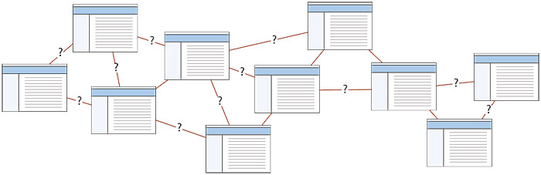
Figure 1 — Don’t make a confusing web of links. Designers aren’t the only ones who make models of sites. Users try to imagine the site structure as well, and a successful information architecture will help the user build a firm and predictable mental model of site.

Slide 10
Web Page Structure
A web page constructed using HTML has a basic and essential structure. The page always begins with the start tag of the html element and always terminates with the end tag of the html element as follows: Example 1
<html> ...web page... </html>
All other element tags are 'nested' within the start and end html tags. The web page is then further subdivided into two main sections which are the 'head' and the 'body'.

Slide 11
Web Page Structure
The head section begins with the <head> start tag and terminates with the</head> end tag.
Immediately following this comes the <body> start tag and just before the html end tag comes the </body> end tag.
There is only one set of <html>...</html> tags,
one set of <head>...</head> tags and
one set of <body>...</body> tags.

Slide 12
How do Web Pages Change
Most pages do not change much.
Larger pages change more often.
Commercial pages change more often.
Past change to a web page is a good indicator of future change.
About 30% of pages are very similar to other pages, and being a near-duplicate is fairly stable.

Slide 13
Link Analysis
Link analysis is a data-analysis technique used to evaluate connections between nodes. Relationships may be identified among various types of nodes (objects), including organization, people and transactions.
The analysis of hyperlinks and the graph structure of the Web has been instrumental in the development of web search.
Link analysis for web search has intellectual antecedents in the field of citation analysis, aspects of which overlap with an area known as Bibliometrics.
Notes:
Bibliometrics is a set of methods to quantitatively analyze scientific and technological literature.
Citation analysis and content analysis are commonly used bibliometric methods.
Link-analysis is the process of building up networks of interconnected objects in order to explore pattern and trends.
Link-analysis is based on a branch of mathematics called "graph theory".(Barry and Linoff, 1997)

Slide 14
Link Analysis
Link analysis is an important part of site assessment, either your own or competitor’s.
Outbound links are links on your site which refer to other sites, they go beyond the borders of your site.
Internal links are links which point to another page of your site, i.e. they refer to some place within your site.

Slide 15
Website Navigation
Website navigation is important to the success of website visitor’s experience to website.
The website’s navigation system is like a road map to all the different areas and information contained within the website.
Types of Website Navigation
Hierarchical website navigation
The structure of the website navigation is built from general to specific. This provides a clear, simple path to all the web pages from anywhere on the website.
Global website navigation
Global website navigation shows the top level sections/pages of the website. It is available on each page and lists the main content sections/pages of the website.
Local website navigation
Local navigation would the links with the text of your web pages, linking to other pages within the website.

Slide 16
Website Navigation Use
To be consistent throughout the website. The website visitors will learn, through repetition, how to get around the website.
The main navigation links kept together. This makes it easier for the visitor to get to the main areas of the website.
Reduced clutter by grouping links into sections. If the list of website navigation links are grouped into sections and each section has only 5-7 links, this will make it easier to read the navigation scheme.
Minimal clicking to get to where the visitor wants to get to. If the number of clicks to the web page the visitor wishes to visit is minimal, this leads to a better experience.

Slide 17
Website Navigation Use
Some visitors can become confused or impatient when clicking a bunch of links to get to where they want to be.
In large websites, this can be difficult to reduce. Using breadcrumbs is one way to help the visitor see where they are within the website and the path back up the navigation path they took.
Creating the website navigation system at the planning stage of the website will effect the overall design of the web page layout and help develop the overall plan for the website.

Slide 18
Web Mining
Web mining can be broadly defined as discovery and analysis of useful information from the World Wide Web.
Based on the different emphasis and different ways to obtain information, web mining can be divided into two major parts: Web Contents Mining and Web Usage Mining.
Web Contents Mining can be described as the automatic search and retrieval of information and resources available from millions of sites and on-line databases though search engines / web spiders.
Web Usage Mining can be described as the discovery and analysis of user access patterns, through the mining of log files and associated data from a particular Web site.

Slide 19
Web Usage Mining
The automatic discovery of patterns in clickstreams and associated data collected or generated as a result of user interactions with one or more Web sites.
Goals
To analyze the behavioral patterns and profiles of users interacting with a Web site.
The discovered patterns are usually represented as collections of pages, objects, or resources that are frequently accessed by groups of users with common interests.

Slide 20
How to perform Web Usage Mining?
Web usage mining is achieved first by reporting visitors traffic information based on Web server log files and other source of traffic data.
Web server log files were used initially by the webmasters and system administrators for the purposes of “how much traffic they are getting, how many requests fail, and what kind of errors are being generated”, etc. However, Web server log files can also record and trace the visitors’ on-line behaviors.
Web log file is one way to collect Web traffic data. The other way is to “sniff” TCP/IP packets as they cross the network, and to “plug in” to each Web server.
Notes:
For example, after some basic traffic analysis, the log files can help us answer questions such as “from what search engine are visitors coming? What pages are the most and least popular? Which browsers and operating systems are most commonly used by visitors?”
After the Web traffic data is obtained, it may be combined with other relational databases, over which the data mining techniques are implemented. Through some data mining techniques such as association rules, path analysis, sequential analysis, clustering and classification, visitors’ behavior patterns are found and interpreted.

Slide 21
Data in Web Usage Mining
Data in Web Usage Mining:
Web server logs
Site contents
Data about the visitors, gathered from external channels
Further application data
Not all these data are always available.
When they are, they must be integrated.
A large part of Web usage mining is about processing usage/ clickstreams data.
After that various data mining algorithm can be applied.

Slide 22
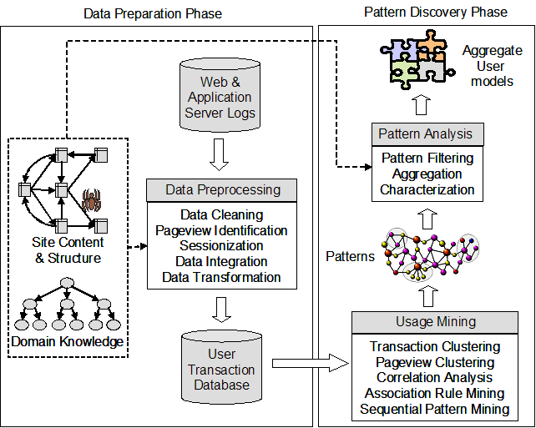
Web usage mining process

Slide 23
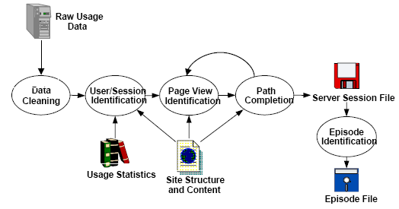
Pre-processing of web usage data

Slide 24
Data Cleaning
Data cleaning
remove irrelevant references and fields in server logs
remove references due to spider navigation
remove erroneous references
add missing references due to caching (done after sessionization)

Slide 25
Identify sessions (Sessionization)
In Web usage analysis, these data are the sessions of the site visitors: the activities performed by a user from the moment she enters the site until the moment she leaves it.
Difficult to obtain reliable usage data due to proxy servers and dynamic IP addresses, missing references due to caching, and the inability of servers to distinguish among different visits.
Notes:
An anonymizer or an anonymous proxy is a tool that attempts to make activity on the Internet untraceable. It is a proxy server computer that acts as an intermediary and privacy shield between a client computer and the rest of the Internet.

Slide 26
Page View
A pageview is an aggregate representation of a collection of web objects contributing to the display on a user’s browser resulting from a single user action (such as a click-through).
Conceptually, each pageview can be viewed as a collection of web objects or resources representing a specific “user event” e.g., reading an article, viewing a product page, or adding a product to the shopping cart.

Slide 27
Path Completion
Client- or proxy-side caching can often result in missing access references to those pages or objects that have been cached.
For instance,
if a user returns to a page A during the same session, the second access to A will likely result in viewing the previously downloaded version of A that was cached on the client-side, and therefore, no request is made to the server.
This results in the second reference to A not being recorded on the server logs.

Slide 28
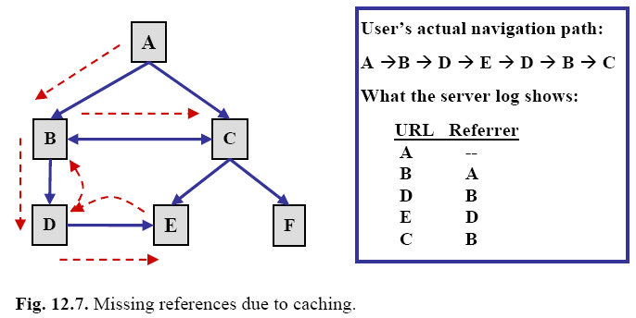
Missing references due to caching

Slide 29
Path completion
The problem of inferring missing user references due to caching.
Effective path completion requires extensive knowledge of the link structure within the site
Referrer information in server logs can also be used in disambiguating the inferred paths.
Problem gets much more complicated in frame-based sites.

Slide 30
Collaborating Filtering
Collaborative filtering(CF) is the process of filtering or evaluating items through the opinions of other people.
CF technology brings together the opinions of large interconnected communities on the web, supporting filtering of substantial quantities of data.
Collaborative filtering systems produce predictions or recommendations for a given user and one or more items. Items can consist of anything for which a human can provide a rating, such as art, books, CDs, journal articles, or vacation destinations.

Slide 31
Collaborating Filtering
Ratings in a collaborative filtering system can take on a variety of forms.
• Scalar ratings can consist of either numerical ratings, such as the 1-5 stars provided in ordinal ratings such as strongly agree, agree, neutral, disagree, strongly disagree.
• Binary ratings model choices between agree/disagree or good/bad.
• Unary ratings can indicate that a user has observed or purchased an item, or otherwise rated the item positively.
The absence of a rating indicates that we have no information relating the user to the item (perhaps they purchased the item somewhere else).

Slide 32
Collaborative Filtering
Match people with similar interests as a basis for recommendation.
Many people must participate to make it likely that a person with similar interests will be found.
There must be a simple way for people to express their interests.
There must be an efficient algorithm to match people with similar interests.

Slide 33
How does CF Work?
Users rate items – user interests recorded.
Ratings may be:
Explicit, e.g. buying or rating an item
Implicit, e.g. browsing time, no. of mouse clicks
Nearest neighbour matching used to find people with similar interests
Items that neighbours rate highly but that you have not rated are recommended to you
User can then rate recommended items

Slide 34
Example of CF MxN Matrix with M users and N items (An empty cell is an unrated item)
Items / Users | Data Mining | Search Engines | Data Bases | XML
Alex | 1 |  | 5 | 4
George | 2 | 3 | 4
Mark | 4 | 5 |  | 2
Peter |  |  | 4 | 5

Slide 35
Observations
Can construct a vector for each user (where 0 implies an item is unrated)
E.g. for Alex: <1,0,5,4>
E.g. for Peter <0,0,4,5>
On average, user vectors are sparse, since users rate (or buy) only a few items.
Vector similarity or correlation can be used to find nearest neighbour.
E.g. Alex closest to Peter, then to George.

Slide 36
Case Study – Amazon.com
Item-to-item collaborative filtering
Find similar items rather than similar customers.
Record pairs of items bought by the same customer and their similarity.
This computation is done offline for all items.
Use this information to recommend similar or popular books bought by others.
This computation is fast and done online.

Slide 37
Recommender systems
Too much information: information overload – consumers have too many options
A recommender system is a system which provides recommendations to a user
Applications: Books, music CDs, movies. Even documents, services and other products such as software games

Slide 38

Recommender
Requester
Recommender
Request for service
Sorted description
of P1,..Pn
Advertisement
of capabilities
Service delegation
•••
Results of service request
Provider 1
Provider n

Slide 39
Information needed
Information used for recommendations can come from different sources:
browsing and searching data
purchase data
feedback explicitly provided by the users
textual comments
expert recommendations
demographic data

Slide 40
Providing recommendations
Recommendations can take the following forms:
Attribute-based recommendations: based on syntactic attributes of products (e.g. science fiction books)
Item-to-item correlation (as in shopping basket recommendations)
User-to-user correlation (finding users with similar tastes)
Non-personalized recommendations (as in traditional stores, i.e. dish of the day, generic book recommendations etc.)

Slide 41
Recommender systems in e-commerce
Turning browsers into customers: they can stimulate the users’ needs (need identification stage)
Cross-selling: suggest additional products which may match the user’s interests or current shopping basket
Personalization: personalized services, or the site can be personalized to the user’s liking – unique shopping experience
Keeping customers informed
Retaining customer loyalty

Slide 42
Collective Intelligence
A shared or group intelligence that emerges from the collaboration and competition of many individuals.
Groups of people and computers, connected by the Internet, collectively doing intelligent things. For example, Google technology harvests knowledge generated by millions of people creating and linking web pages and then uses this knowledge to answer queries in ways that often seem amazingly intelligent.
In Wikipedia, thousands of people around the world have collectively created a very large and high quality intellectual product with almost no centralized control, and almost all as volunteers!

Slide 43
Examples
One example of collective intelligence would be political parties and the way in which the take the views of the people to form policies, select their candidates and run election campaigns.
Online multi-player games are another example of collective intelligence. Games such as Halo, Second Life and Call of Duty rely on gamers coming together as a community to form the game’s Identity.

Slide 44
Examples
The online encyclopaedia Wikipedia is one of the best examples of collective intelligence. Anyone can add information to an exiting page or indeed create a new page of information; pages also hyperlink to other areas of the website that people have edited.
Google is a prominent example of collective intelligence. The search engine is made up of millions of websites, which have been created by people all over the world.

Slide 45
Examples
The social networking world is perhaps the most popular of collective intelligence. Friend post statuses which then act as newsfeed, which informs other friends of their thoughts. Friends can also recommend other friends, applications and pages to any person on their friend list.

Slide 46
Example
If a person has a Amazon account they can buy or sell products to other people with accounts this is collective intelligence because the people are making up the website.
The website also recommends items that may also interest you judging on what you have already looked at which is collective intelligence also.
Things such as customer reviews can also be heavily influential when choosing a product. You are essentially basing your opinion off of the opinions of other members of the public.

Slide 47
Web content mining, also known as text mining, is generally the second step in Web data mining. Content mining is the scanning and mining of text, pictures and graphs of a Web page to determine the relevance of the content to the search query. This scanning is completed after the clustering of web pages through structure mining and provides the results based upon the level of relevance to the suggested query.
Thank You

